Slide 1
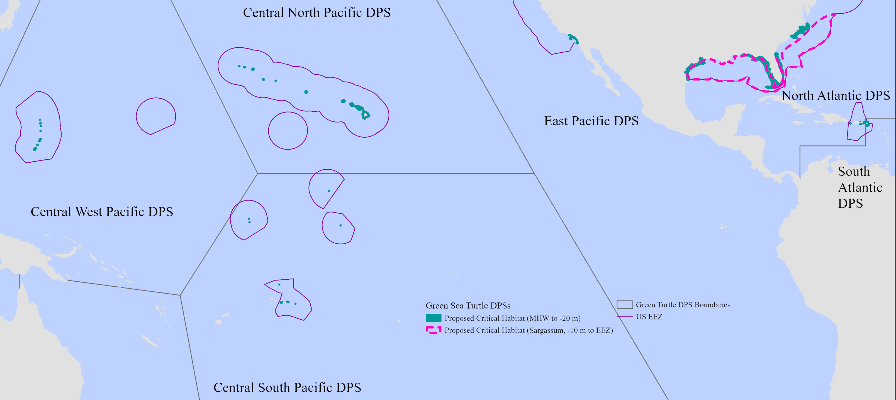
Proposed Marine Critical Habitat for the Atlantic Green Turtle DPSs
Notes:
NOAA Fisheries is proposing to designate critical habitat for the North and South Atlantic Distinct Population Segments (DPSs). DPSs are discrete populations that are significant to the species.
The gray lines are the boundaries for the green turtle DPSs. The purple lines are the US Exclusive Economic Zone or areas within US jurisdiction. The areas in green and within the pink dashed line are proposed marine critical habitats.

Slide 2
Features essential to the conservation of Atlantic green turtle DPSs in the marine environment
Essential Feature | Life Stage | Life History Need | Habitat
Reproductive | Adult Hatchling | Mate, transit, internest Transit, “swim frenzy” | MHW – 20 m
Migratory (North Atlantic only) | Adult | Migrate | MWH – 20 m
Foraging/ Resting | Post-hatchling Small juvenile | Forage, rest, thermoregulate | 10 m – EEZ (Surface-pelagic)
 | Juvenile Subadult Adult | Forage, rest, thermoregulate | MWH – 20 m (Benthic)
Notes:
Based on the life history needs of each DPS and the best available scientific information, the Team identified three categories of essential features: reproductive, migratory, and foraging/resting. Post hatchlings and small juveniles forage and rest in surface-pelagic or Sargassum habitats. And larger juveniles, subadults, and adults forage on seagrass, macroalgae, and invertebrates in benthic habitats. They also rest in corals, rocks, or man-made strucures in benthic habitats.

Slide 3
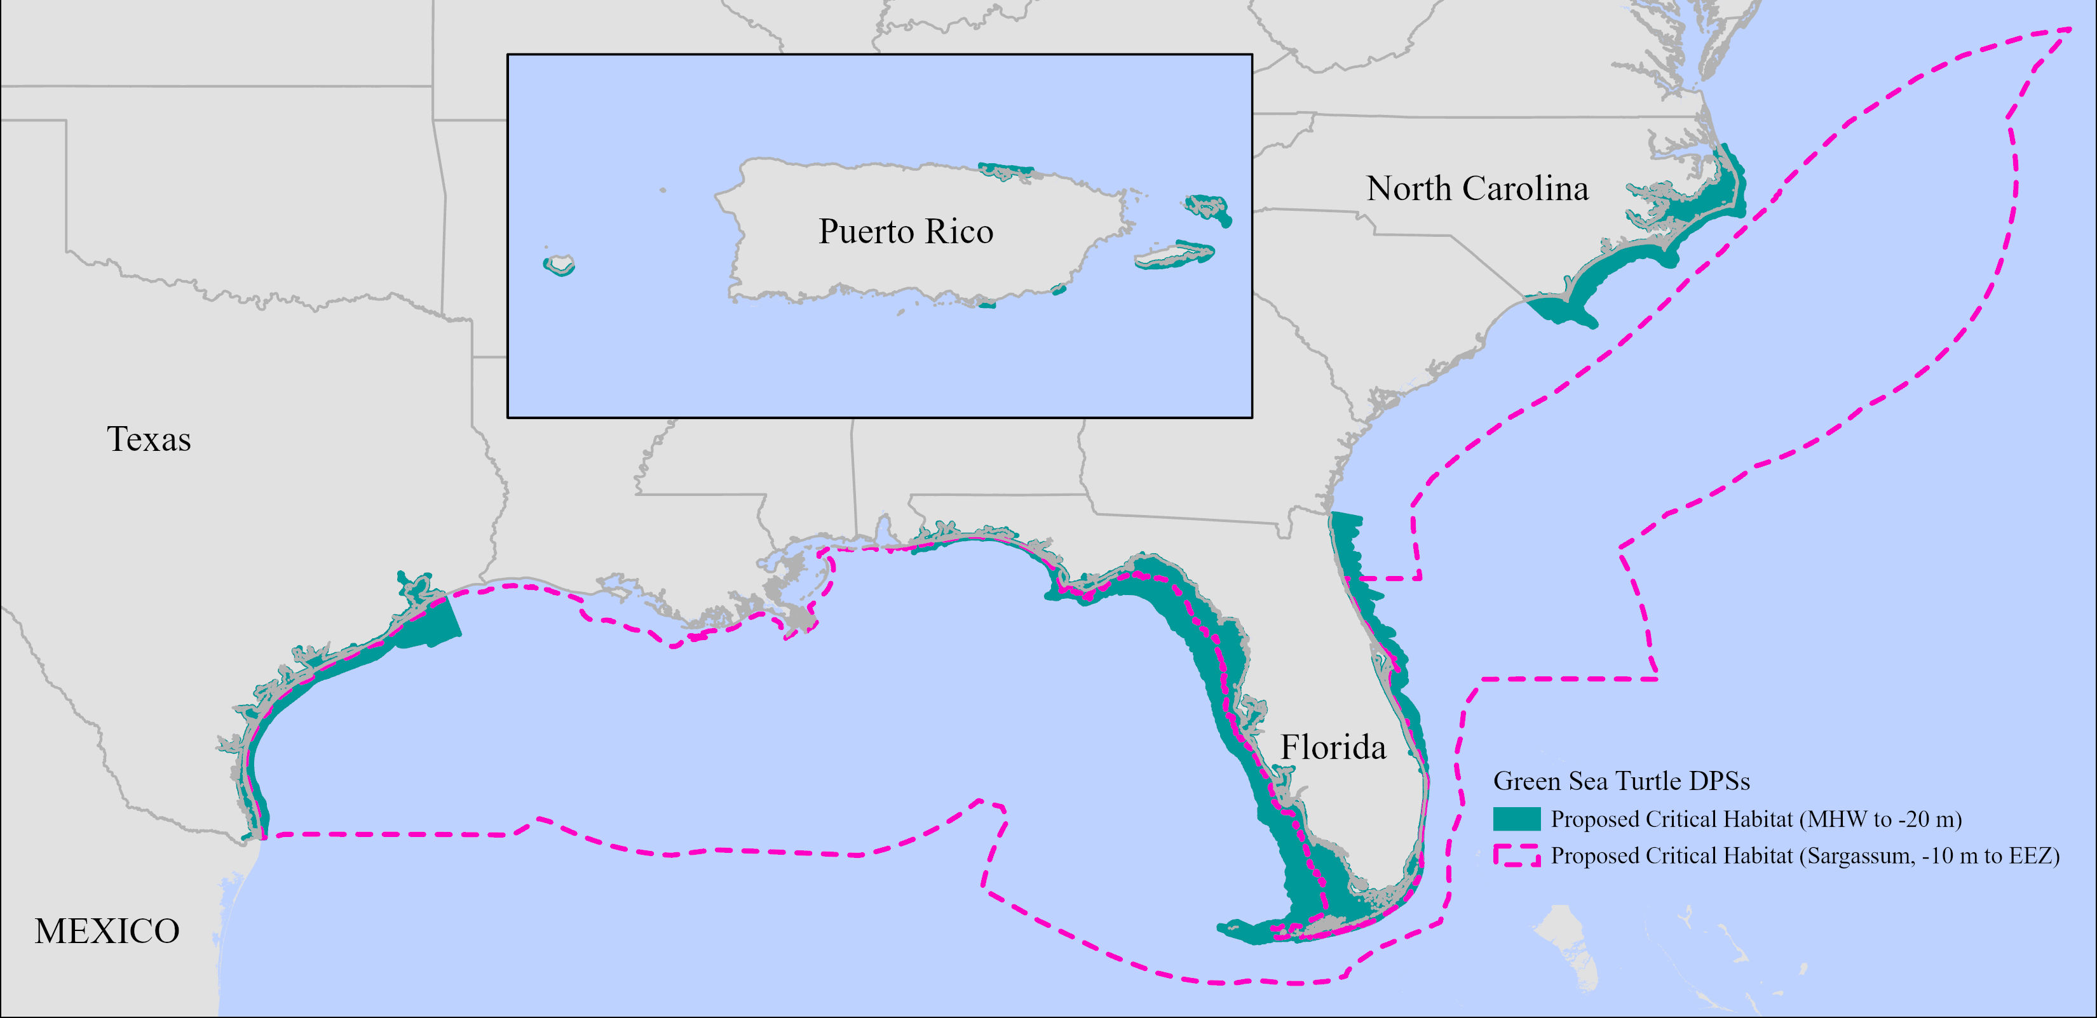
North Atlantic DPS
Notes:
We are proposing to designate areas from the mean high water line to 20 m depth (shown here in green). In Florida, these areas contain the reproductive, migratory, and benthic foraging/resting features. In Texas and North Carolina, these areas contain the benthic foraging/resting features. In Puerto Rico, areas off Mona Island, Vieques Island, Maunabo and Guayama contain reproductive and benthic foraging/resting features. Areas off Culebra and Northeast Puerto Rico Island contain benthic foraging/resting features.

Slide 4
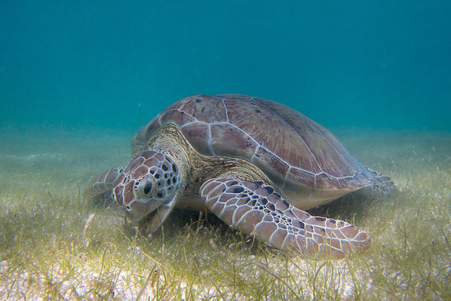
South Atlantic DPS
Notes:
We are also proposing to designate areas from the mean high water line to 20 m depth (shown here in green) in the USVI. In St. Croix, these areas contain the reproductive and benthic foraging/resting features. In St. Thomas and St. John, these areas contain the benthic foraging/resting features.

Slide 5
Notes:
Critical habitat is habitat that is essential to the conservation of a species, or in this case DPS. It creates a regulatory requirement that applies only to actions funded, permitted, or carried out by the Federal government. It is not a sanctuary. You can still fish, swim, boat in areas of critical habitat. There are no signs and no restrictions for non-Federal actions. Federal agencies are required to consult with NOAA Fisheries and ensure that their actions do not destroy or modify critical habitat. Federal agencies are already consulting on the turtles, which have been listed under the ESA since 1978.

Slide 6
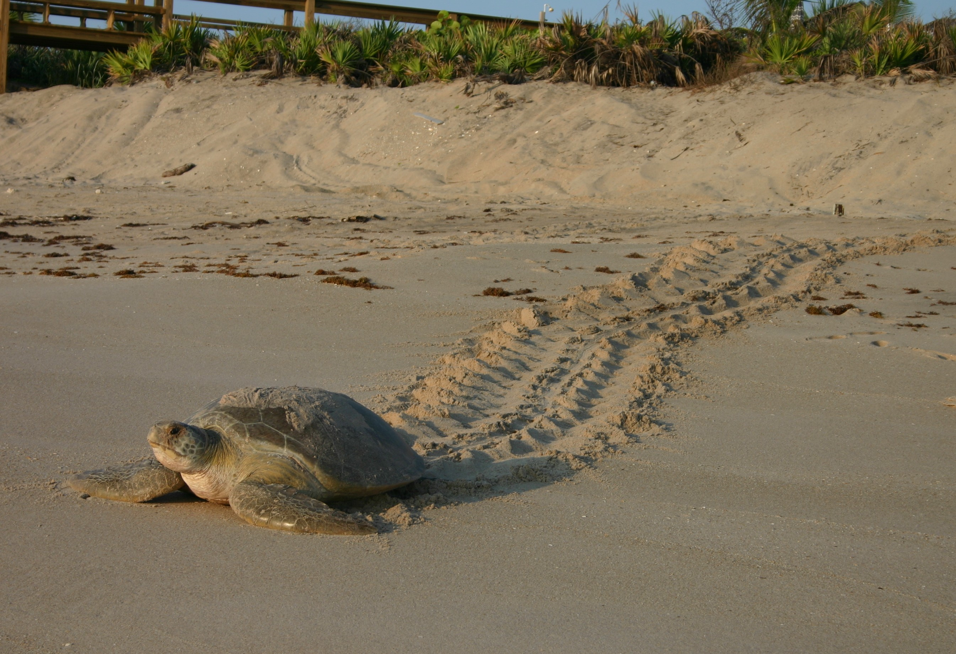
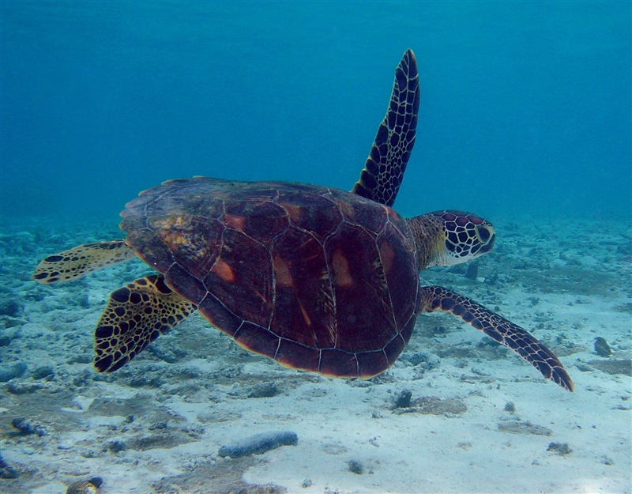
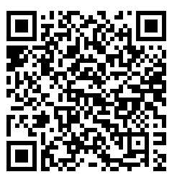
Submit comments by October 17, 2023:
Regulations.gov
FWS-R4-ES-2022-0164
NOAA-NMFS-2023-0087
Public hearings, or
Via mail (see websites for more information):
https://www.fws.gov/library/collections/green-sea-turtle-critical-habitat
https://www.fisheries.noaa.gov/action/critical-habitat-green-sea-turtles
Notes:
We would like your comments on this proposed rulemaking. It is especially useful for us to receive data or traditional knowledge on green sea turtle habitats. Please provide all comments using one of these methods by October 17, 2023

Slide 7
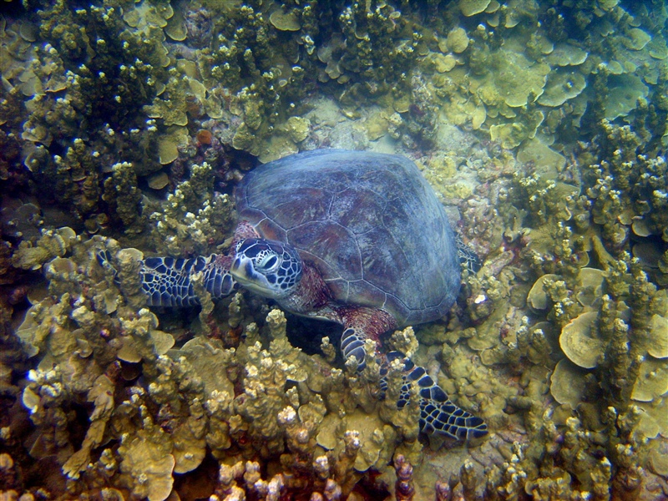
Timeline
July 19, 2023 Proposed rule published
August 29, 2023 Virtual informational meeting and public hearing: informational meeting at 6:00 PM, public hearing from 7:00 to 8:00 PM
October 17, 2023 Comments due
March-May 2024 Federal inter-agency review (90 days)
July 19, 2024 Publish final rule to designate critical habitat
Notes:
Here is our timeline. Our final rules to designate critical habitat are due July 19, 2024.

