Slide 1
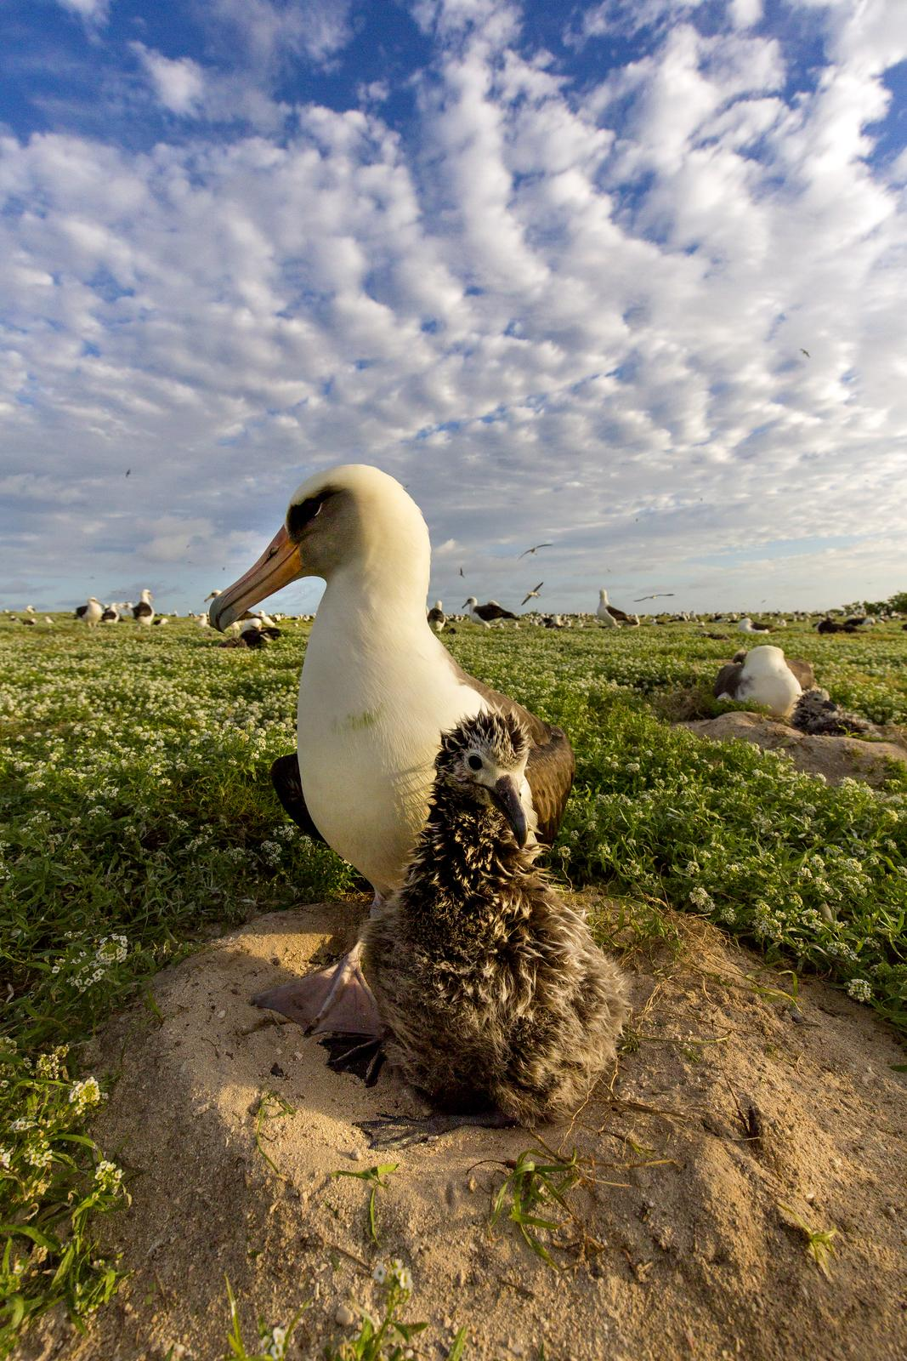
HOLY MŌLĪ
USFWS & Papahānamokuākea
Midway Atoll
Homes of the Albatross
Boluses
USFWS Refuges
USFWS External Affairs
Boluses

Slide 2
https://www.youtube.com/watch?v=un9y70Dw9Rc
PAPAHĀNAMOKUĀKEA MARINE NATIONAL MONUMENT
Notes:
This whole region of the archipelago is Papahanamokuakea is a marine national monument, which means that it is protected with the intent of keeping wildlife and their habitat safe. The monument includes all of these tiny islands and atolls, as well as the waters out to the boundary line that you can see here! Each of these islands is unique –with different densities of certain species, different landscapes, and many other variable factors. The area we are most concerned with today is Midway Atoll –here, over 1000 miles northwest of Hawaii.

Slide 3
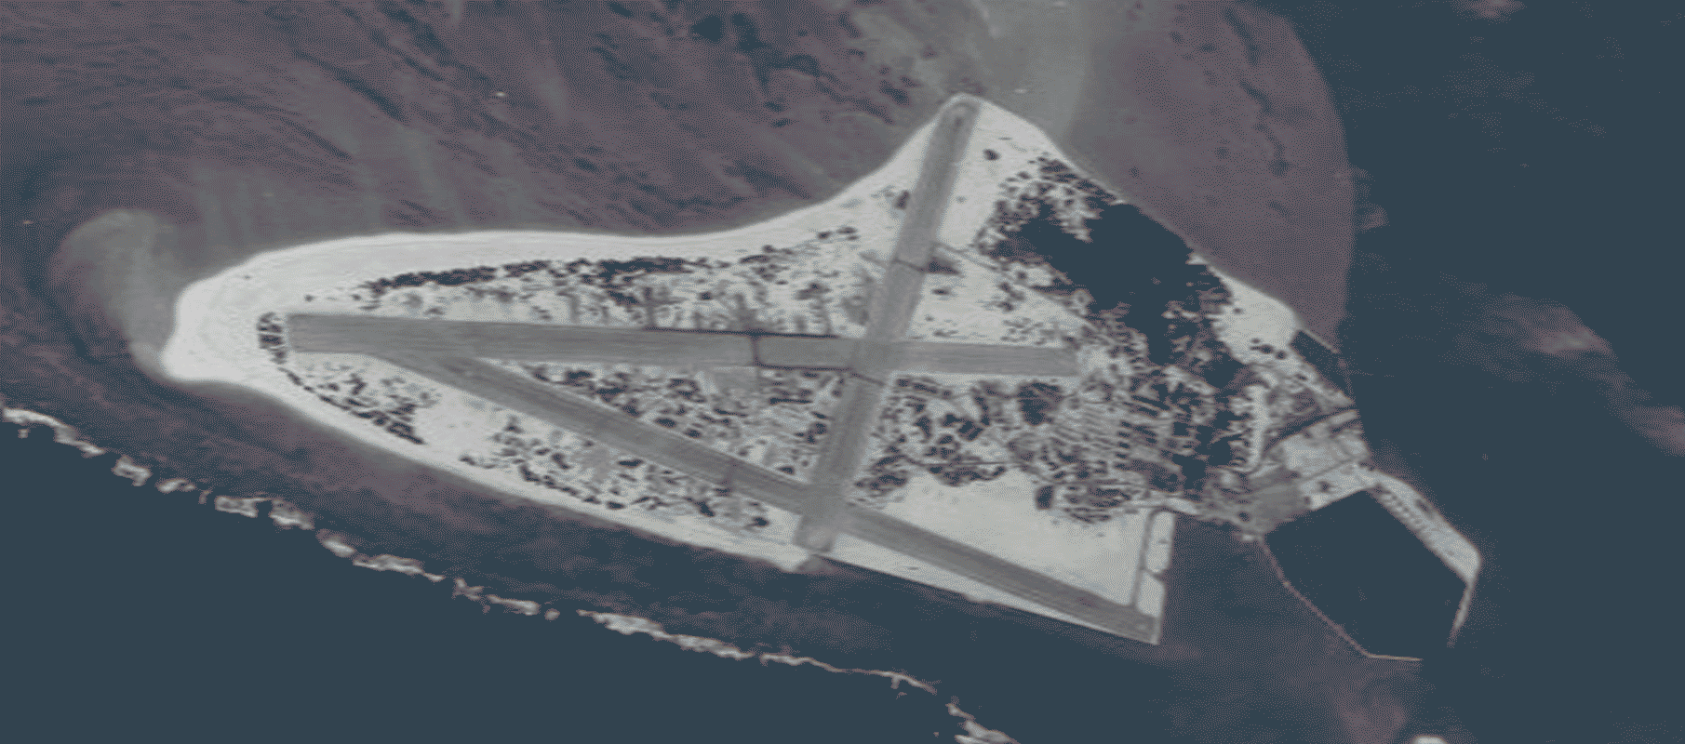
Midway Atoll // Kuaihelani
National Wildlife Refuge + Marine National Monument + National Memorial
Home to over 3 million seabirds!
Provides habitat for endangered marine life
Notes:
Midway is home to the worlds largest albatross nesting colony in the world. Home to many species of seabird, serves as one of only two nesting sites of the endangered short-tail albatross, and is also important habitat for Hawaiian green sea turtles and Hawaiian monk seals. Pictured here is one of the main focuses of today –the Laysan albatross. Most of their life is spent out at sea , foraging to feed themselves and their young. 7 foot wingspan!
The gif shows the change in landscape and erosion overtime from 1945 to 2017.

Slide 4
James Campbell NWR // Kahuku, North Shore, Oahu
Laysan and Black-footed albatross
Founded in 1976 for 4 endemic and endangered water birds; the ʻalae ula, ʻalae keʻo keʻo, aeʻo, and koloa maoli
Notes:
James Campbell National Wildlife Refuge is a wetland and coastal sanctuary for many threatened or endangered, native and endemic Hawaiian species. Located in the Kahuku ahupua‘a of the Ko‘olauloa moku. Compromised of 2 wetland areas and home to the laysan and black-footed albatross as well as many other seabird species.
Established in 1976, James Campbell is home to endangered waterbirds, migratory shorebirds, waterfowl, seabirds, endangered and native plant species, endangered ‘īlio-holo-i-ka-uaua (Hawaiian monk seal), and threatened honu (Hawaiian green turtle); providing increased wildlife-dependent public uses; and assisting with flood damage reduction in the local area.
‘alae ula, the Hawaiian Gallinule (Moorhen)
‘alae ke’o ke’o, the Hawaiian Coot
Ae’o, Black necked stilt
Koloa maoli, Hawaiian duck
the refuge is generally closed to the public, BUT people can definitely reach out if they are interested in volunteering, AND our bird tour season will be starting back up again in October (through Feb) which is every Sat morning from 8-10.

Slide 5
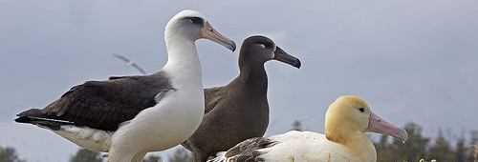
Albatross
Midway is home to the largest nesting colony (1 million+)
Spend months at a time soaring over the ocean (50 mph+)
Long life span - Wisdom is 66 years old!
“Charismatic” birds
Notes:
Incredibly long life span –Wisdom is the oldest known albatross 66 years old! (may be even older but she was banded so her age is the oldest certain age).
These birds are incredible –just last week I returned from a 2 week trip to Midway and I was mind-blown by the size and number of these birds. (house –2 to 100!!) These birds mate for life and have intricate courtship rituals –noises and dances! Also have high nest site fidelity, so when once they create their first nest they will return to almost the exact same spot each subsequent year!

Slide 6
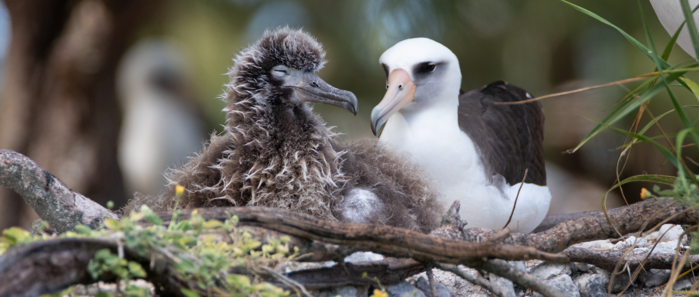
Laysan Albatross // Mōlī // Phoesbastria immutabilis
Notes:
Found on the main Hawaiian Islands and most common. On Oahu can be spotted at places such as Kaena Point. Have any of you seen a laysan albatross before? Where have you seen them? What do you remember about them (size)? They are at James Campbell. Currently not listed but has a status of “near threatened” with a stable population.

Slide 7
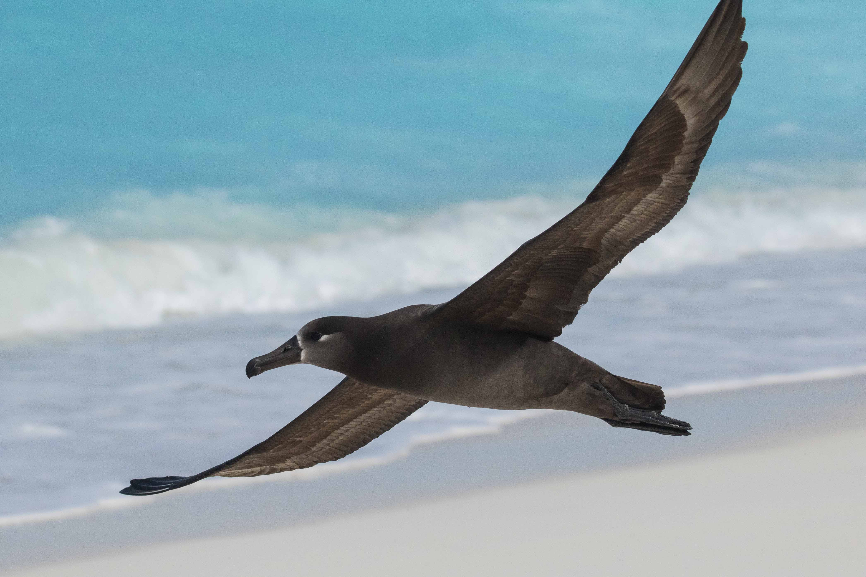
Black-footed Albatross // Ka’upu // Phoebastria nigripes
Notes:
Also found at NWR James Campbell on Oahu in Kahuku. Currently not listed but has a status of “near threatened”, with population decreasing.

Slide 8
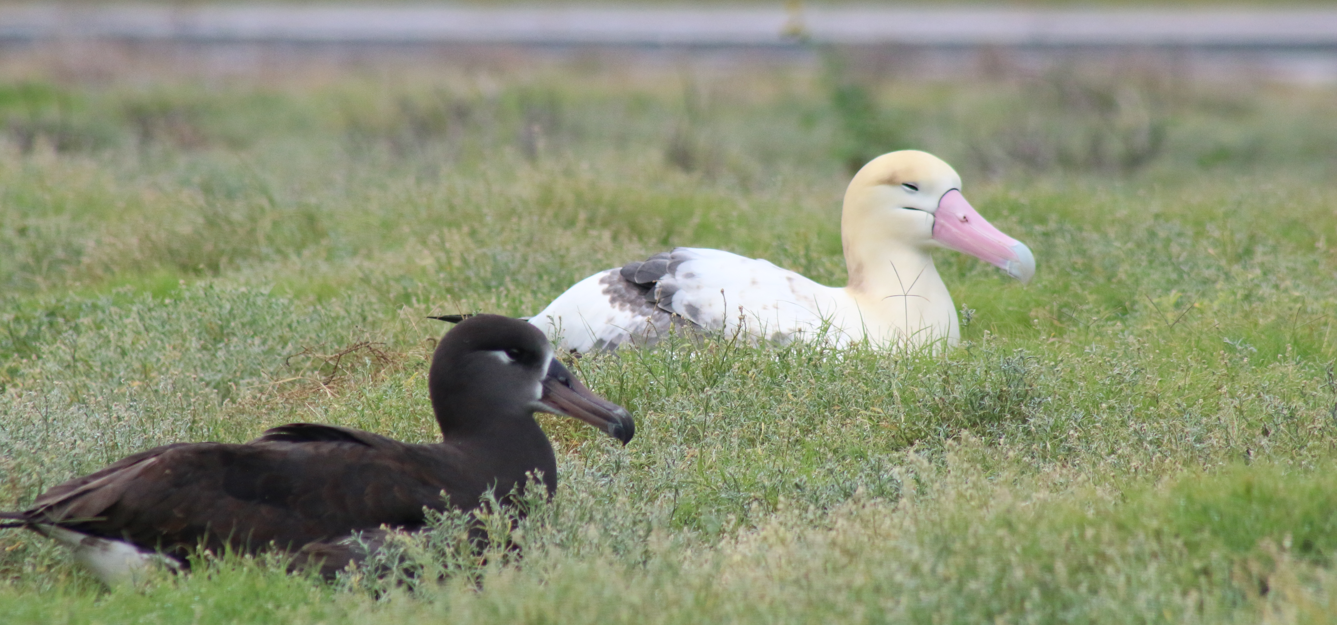
Short-tailed Albatross // Makalena // Phoebastria albatrus
Notes:
Only listed albatross species, current status is “vulnerable” with population increasing. Not found on the main Hawaiian islands .

Slide 9
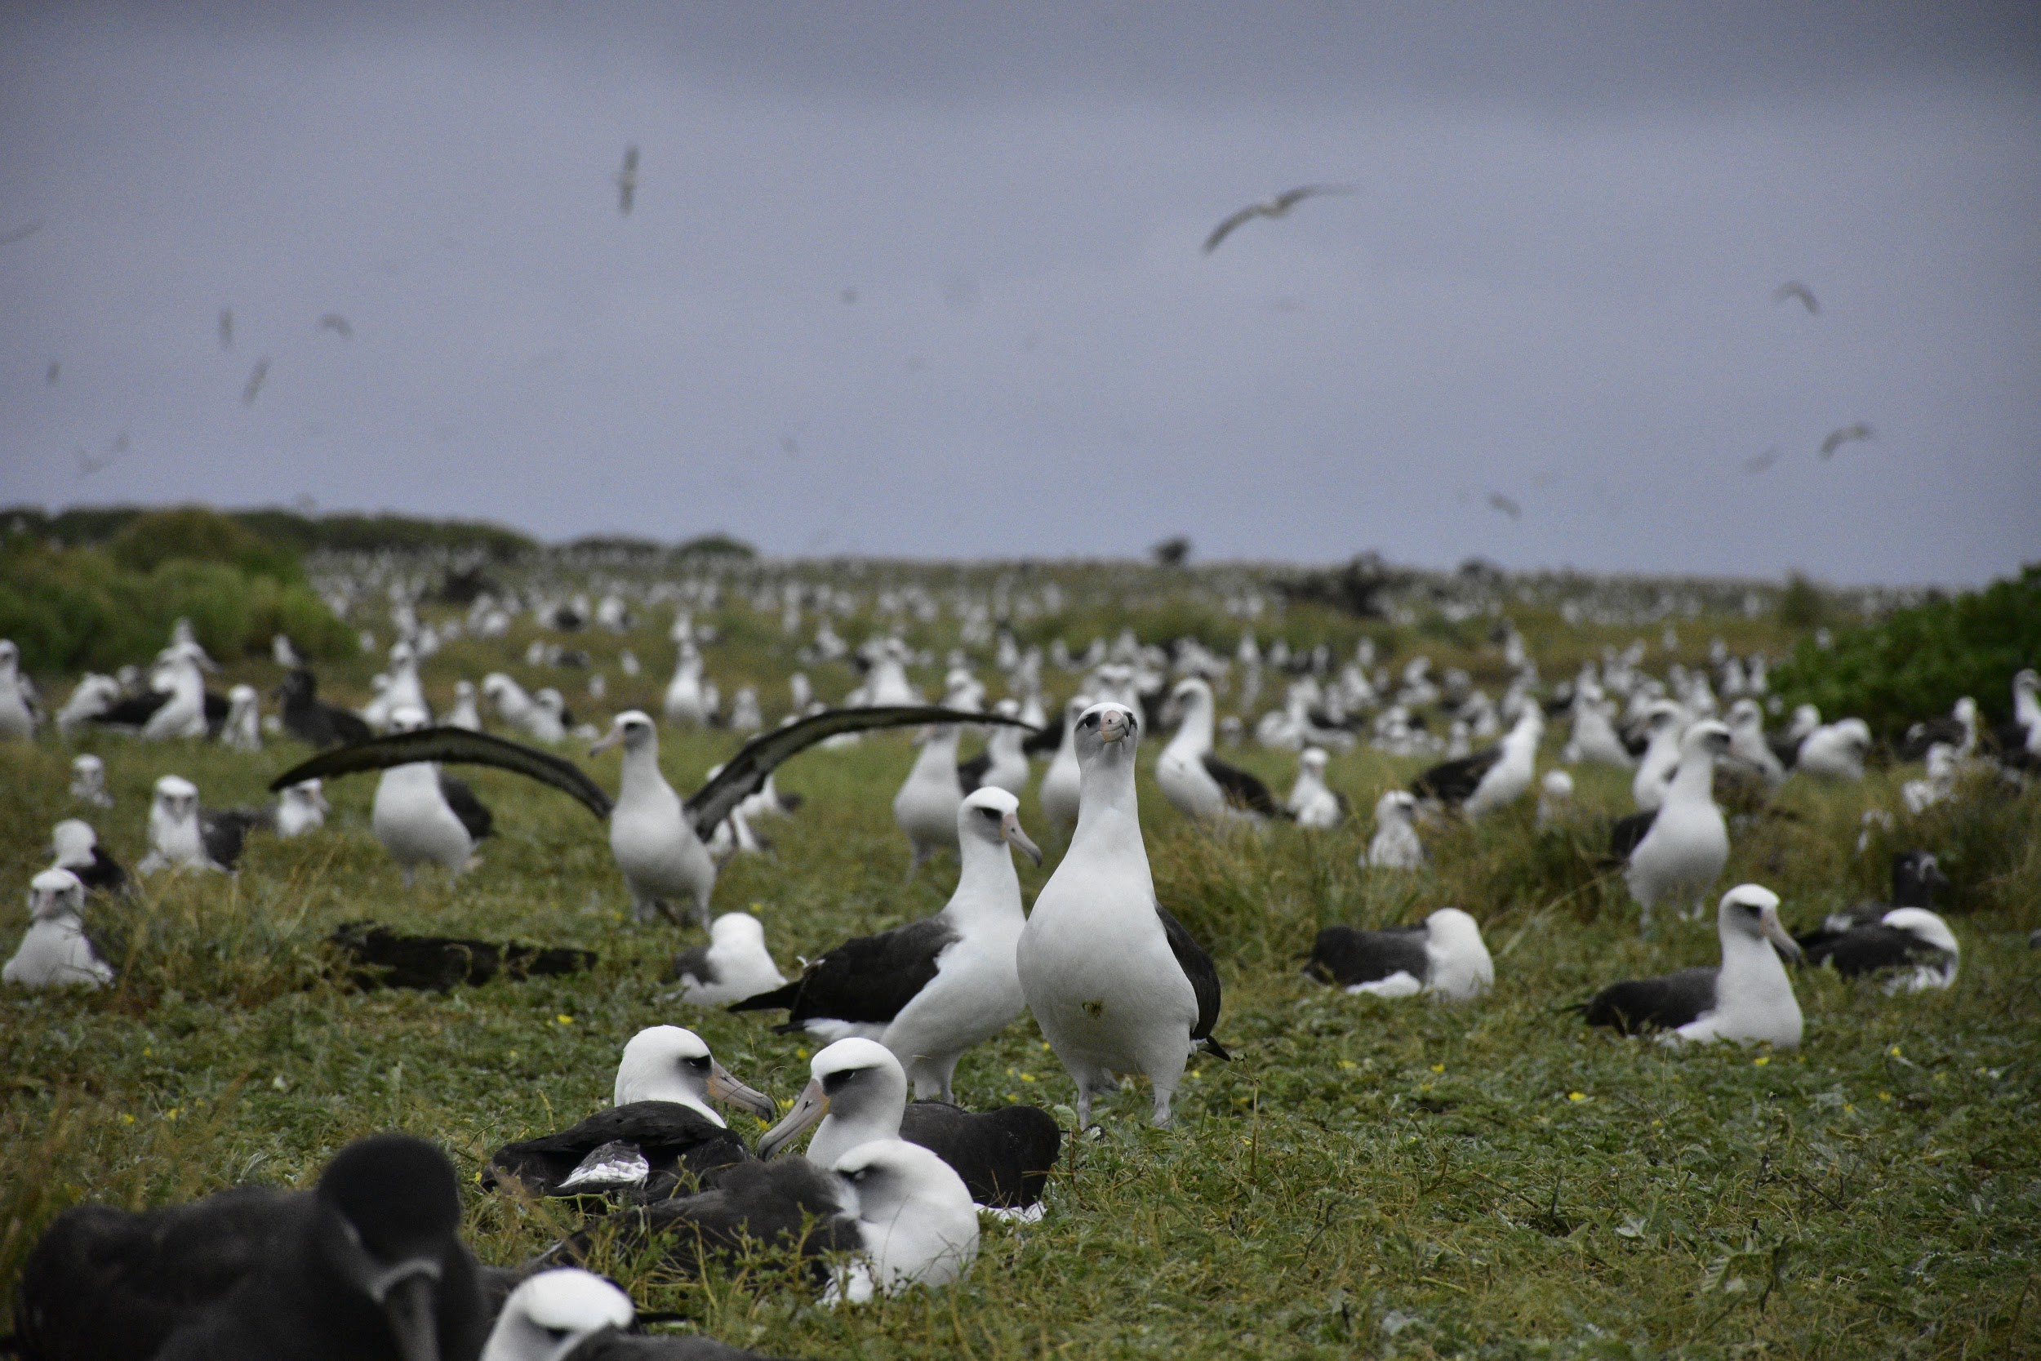
Video of courtship

Slide 10
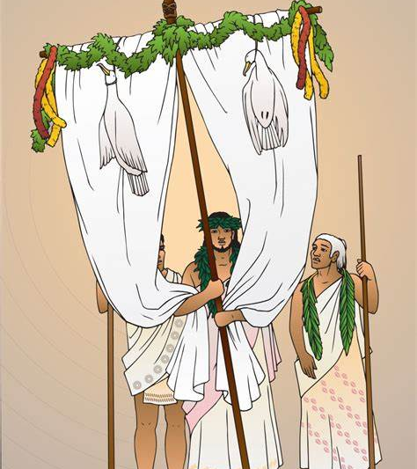
Cultural Importance
“the feathers (actually the whole pelt) of Black-footed Albatrosses or Ka’upu are used to make a standard or staff depicting Lono [Hawaiian god of farming and fertility] that is carried in a procession during the Makahiki season [ancient Hawaiian New Year festival] – Beth Flint USFWS
Notes:
Lono-makua is depicted in the picture and the staffs carried for him usually had suspended albatross skins. These were carried around the island during the Makahiki season, mid-November to late January or early February aligning with the rainy or wet season.

Slide 11
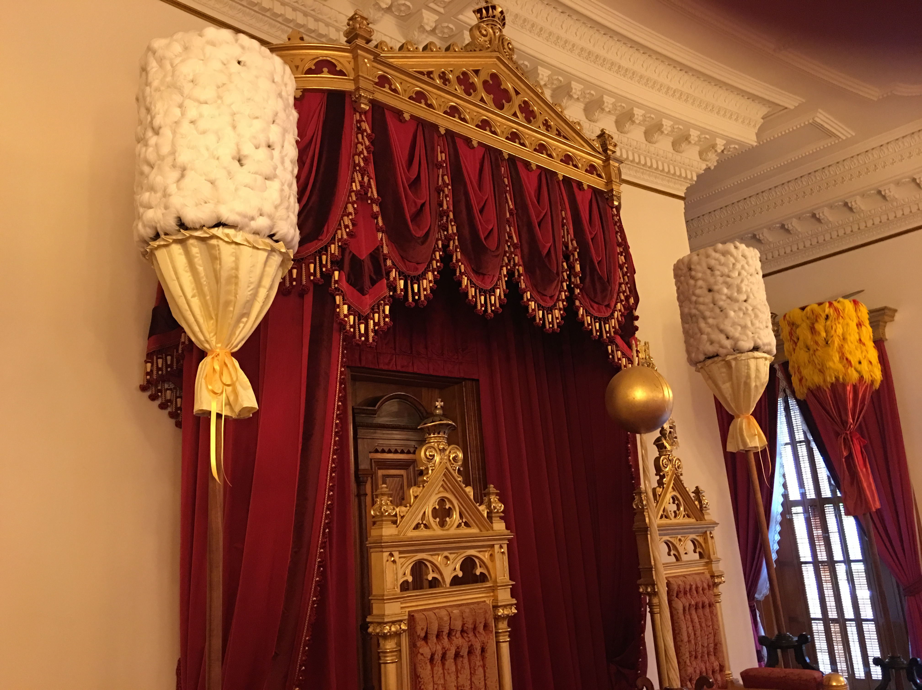
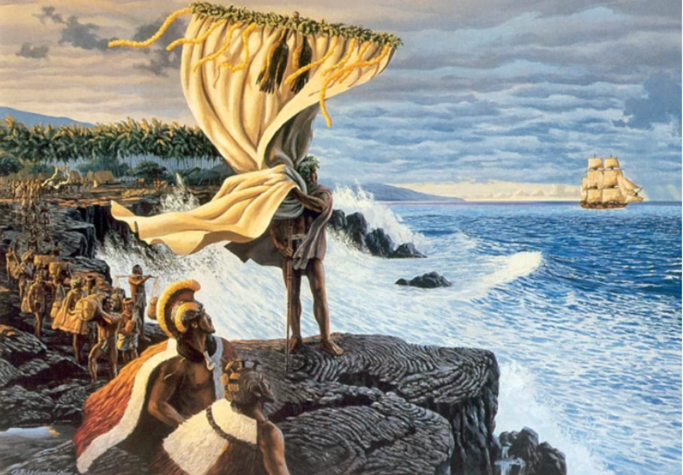
“In terms of Hawaiian culture, I am … aware of the use of Laysan Albatross bones for tattoo needles. They too are called Mōlī”. - Hob Osterlund, Kaua’I Albatross Network
The kahili (royal standards) created from Kaʻupu and Mōlī feathers. These kahili stand on either side of the thrones at Iolani Palace in Honolulu.
Notes:
The top right is a picture of the Kahili at Iolani Palace that are made of Ka’upu and Moli feathers.
Bottom left photo depicts members of the Kiamanu Project that use feathers collected from Kure Atoll to create lei, moli, and kahili. Kiamanu is the olelo Hawaii term for master feather worker.

Slide 12
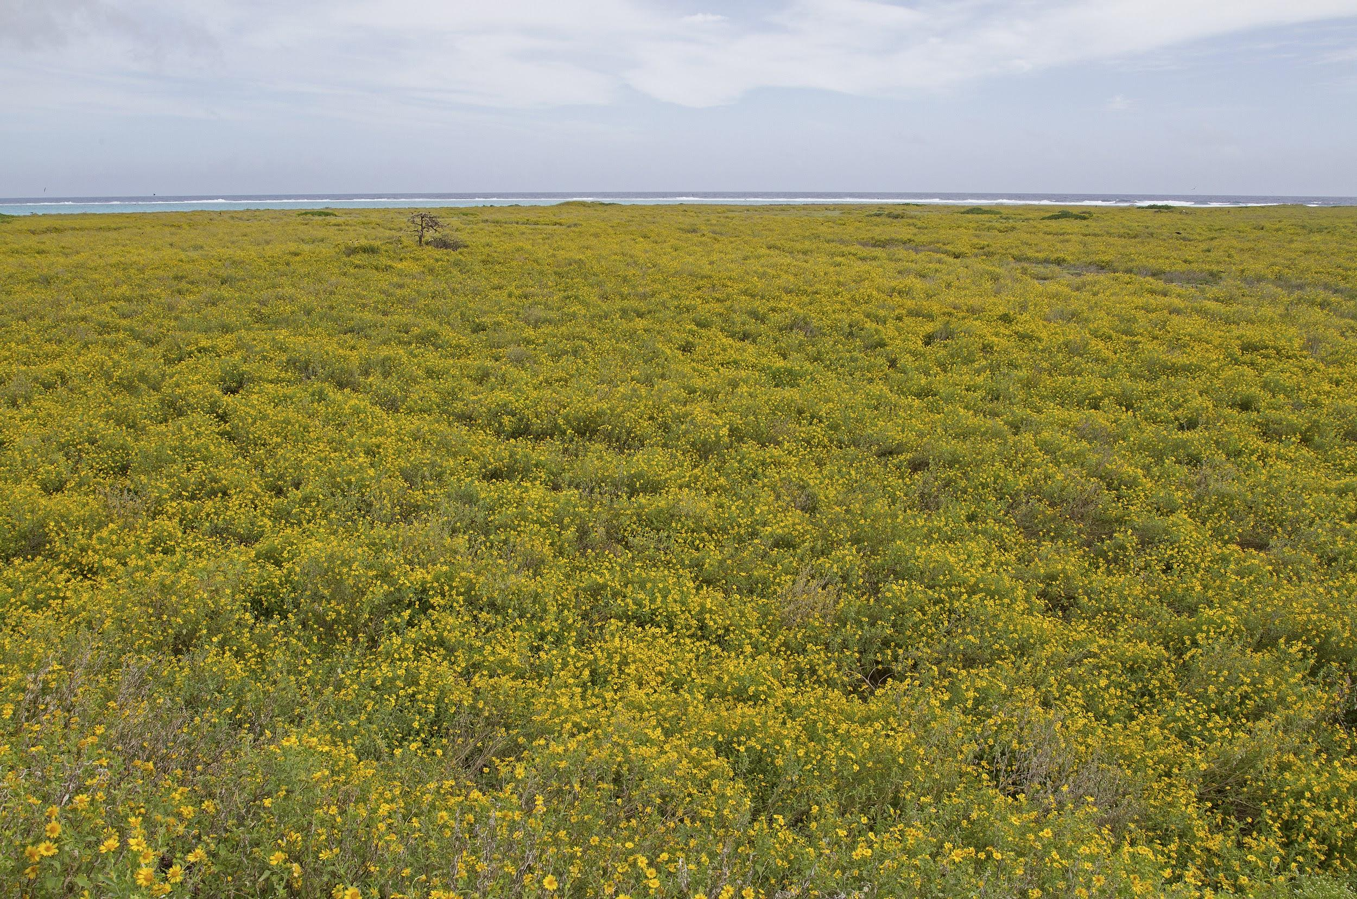
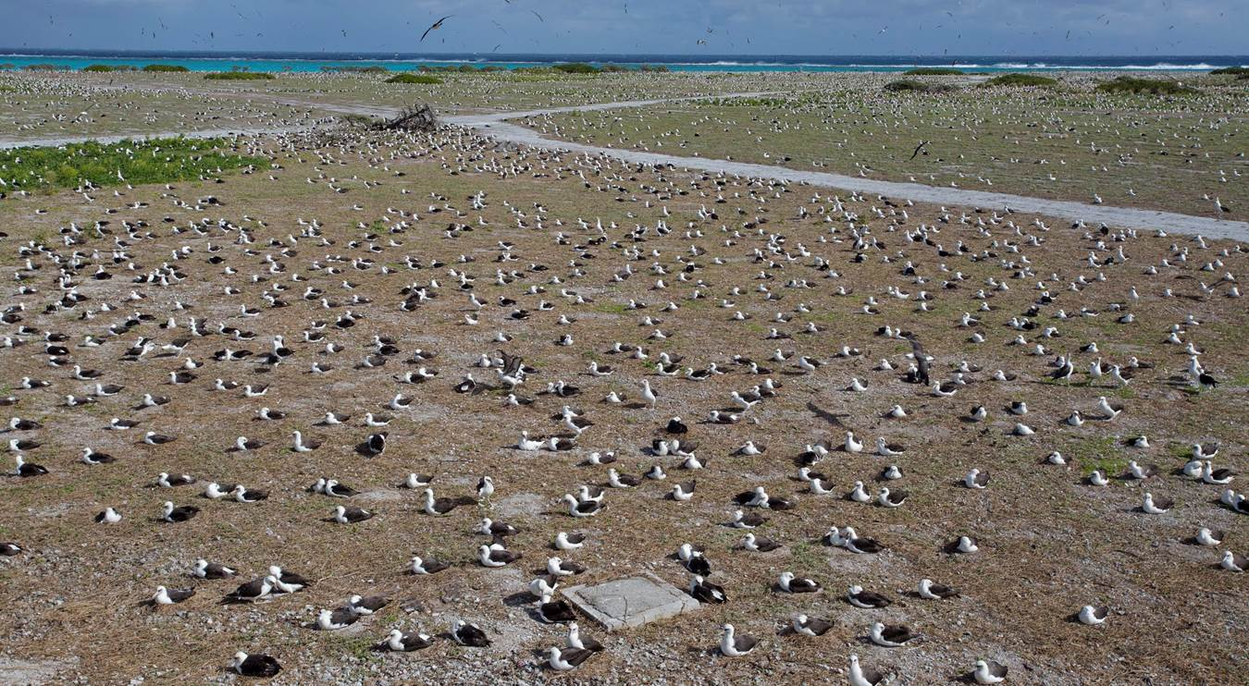
Verbesina to native
Making Home Safe: Invasive Verbesina → Nesting Habitat
Notes:
The biologists, resource managers, and volunteers at Midway continue to work hard to establish and maintain safe habitat for seabirds. One example is verbesina.
So what do you see here? (answer -- no birds!!!)

Slide 13
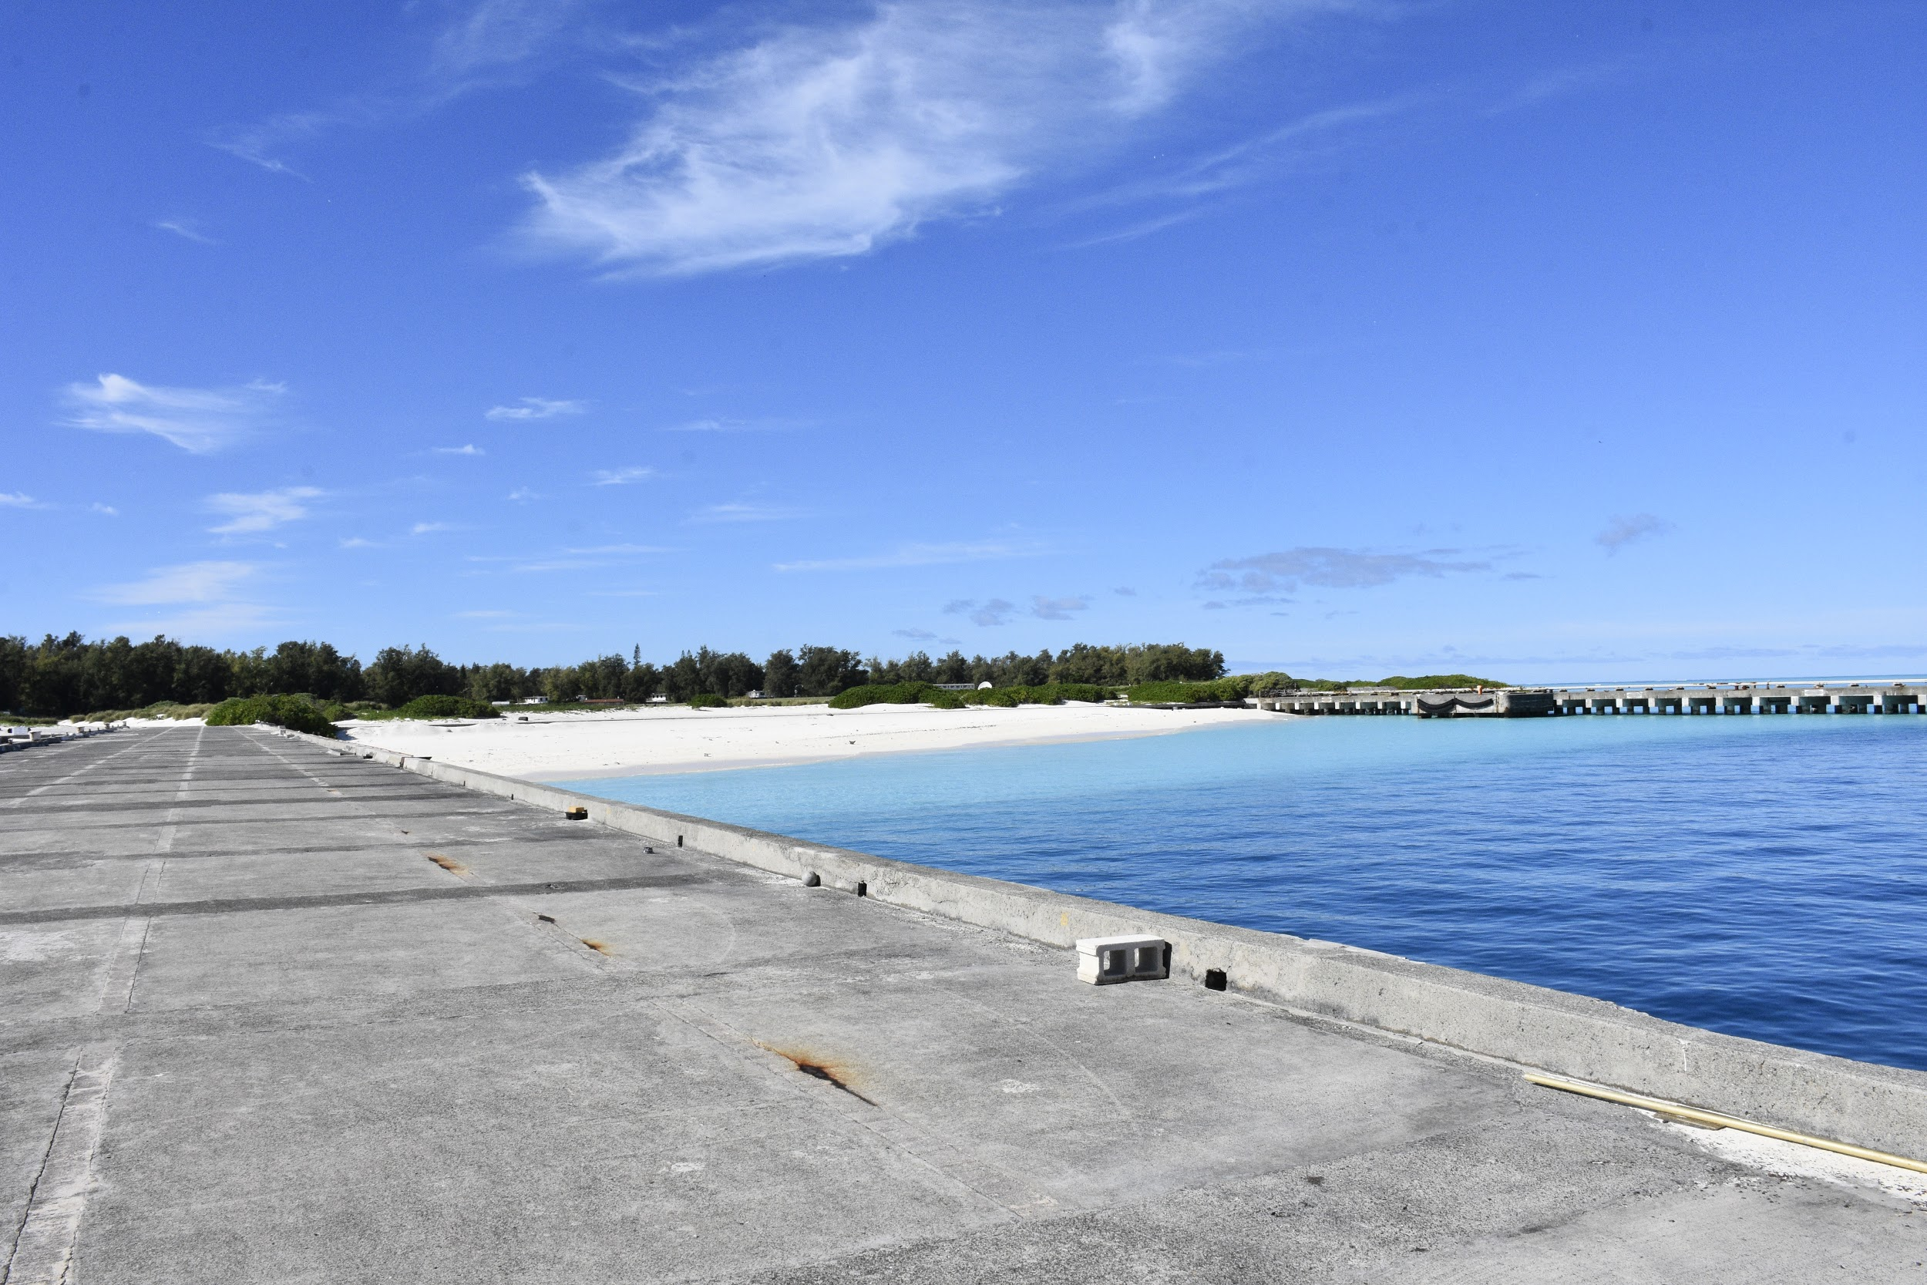
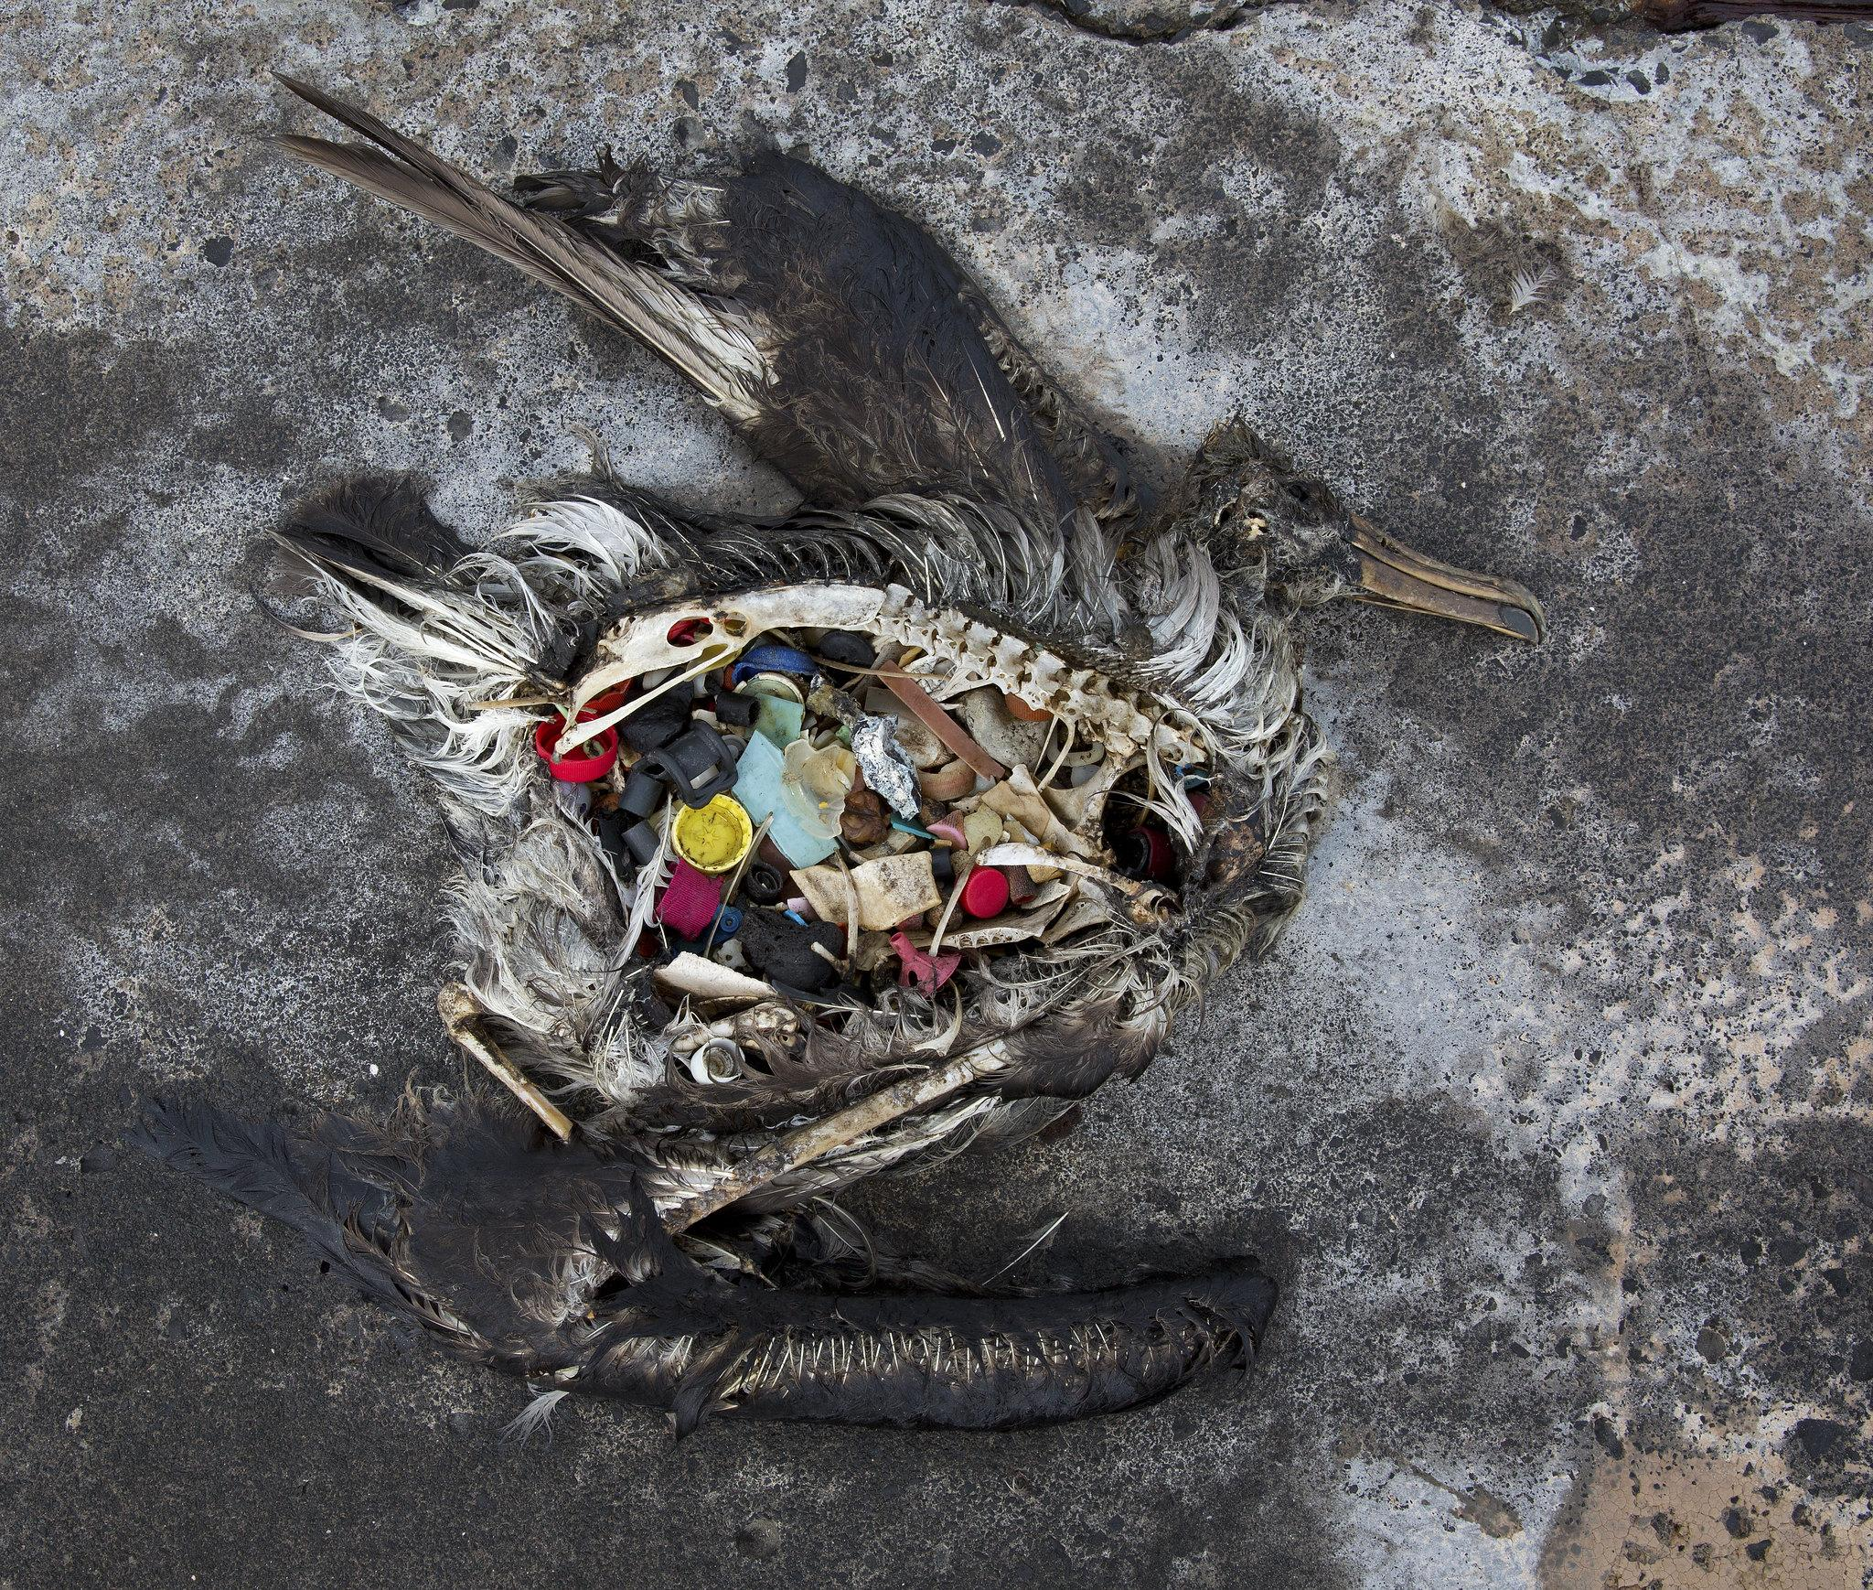
Albatross feed and spend the majority of their life over the ocean, so maintaining a healthy marine environment is crucial for their survival.
Why would an albatross eat all of these things?
Notes:
Rememberwhen the albatross aren’t on Midway, they are soaring above and around the ocean. What would you guess that they eat?
Bring up fish eggs! And the love for fish eggs is where plastic becomes extra problematic. Eggs can be laid on floating surfaces, including plastics, and as the albatross dives to gather the eggs may incidentally also ingest plastic.

Slide 14
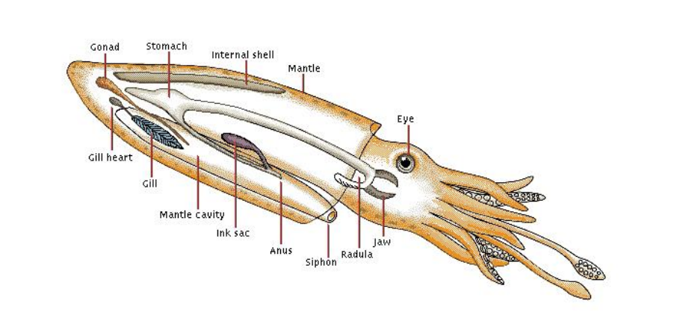
Squid
Notes:
Albatross favorite meal is squid! They can see the glistening of a squid near the surface of the water. The albatross dive down to eat the squid, sometimes mistaking plastic or marine debris as squid. Debris or other matter, organic or inorganic is sometimes scooped up along with the squid as well.
The red circle indicates a squid beak, this is the only indigestible part of the squid, meaning the only part you will see in the bolus.

Slide 15
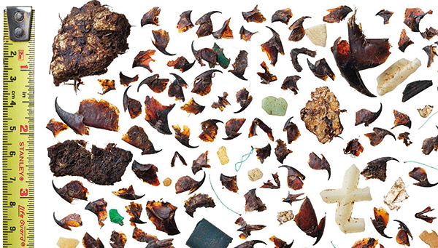
Notes:
This is an example of all the contents of a single bolus.
Ask students to identify what they see in the image, you can have them point or you can point and ask them what they think that item is.

Slide 16
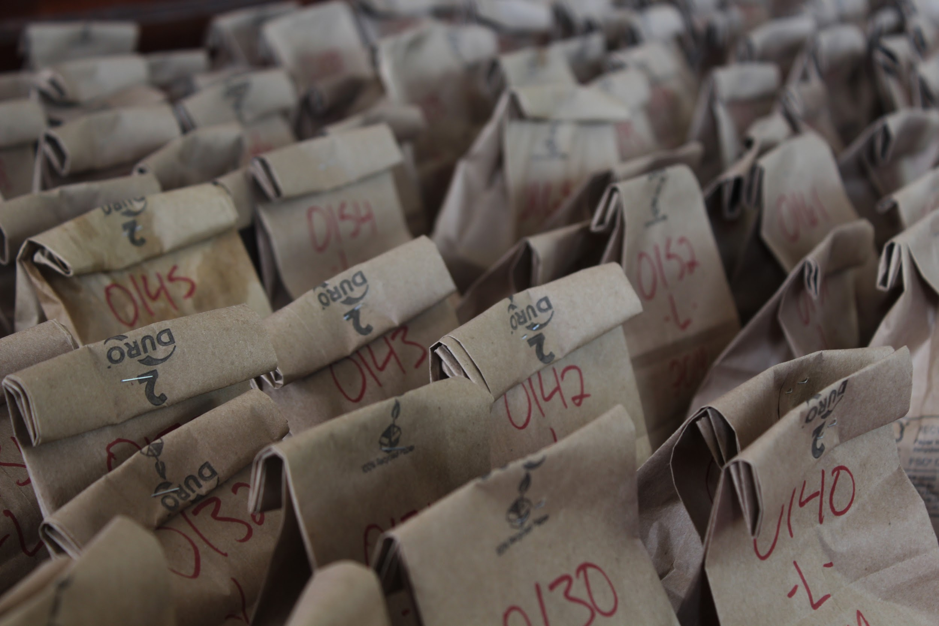
Bolus Video Today you all will join our Bolus Education Program! So what is the purpose of a bolus? & why dissect boluses?

Slide 17
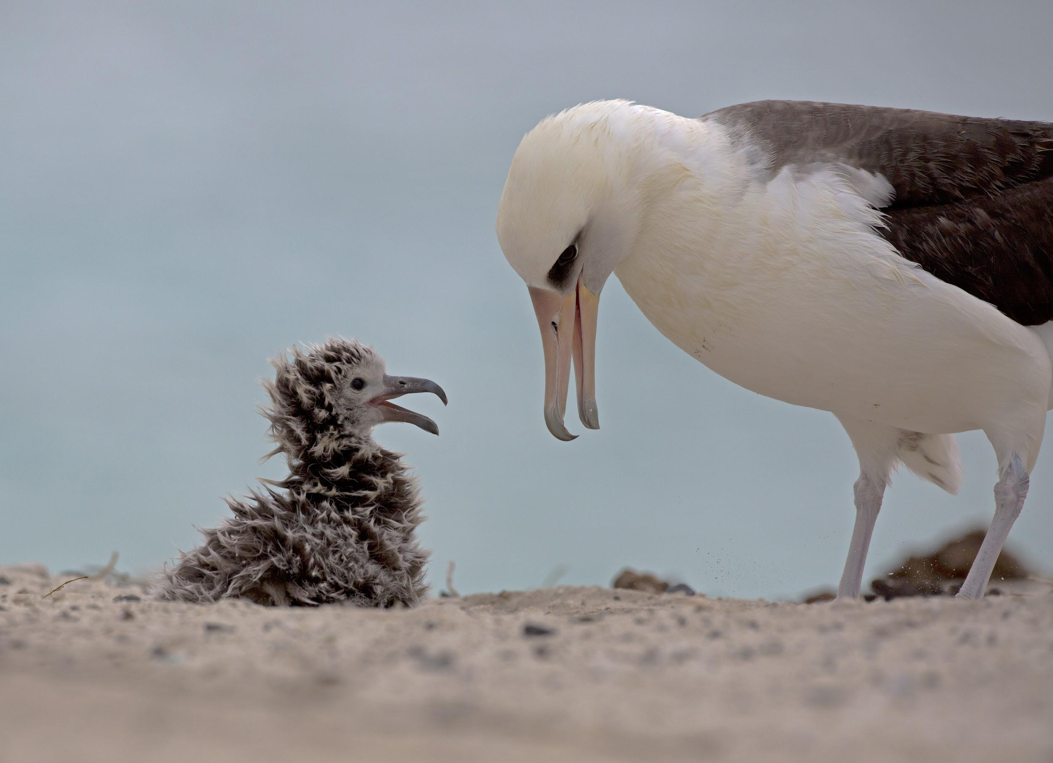
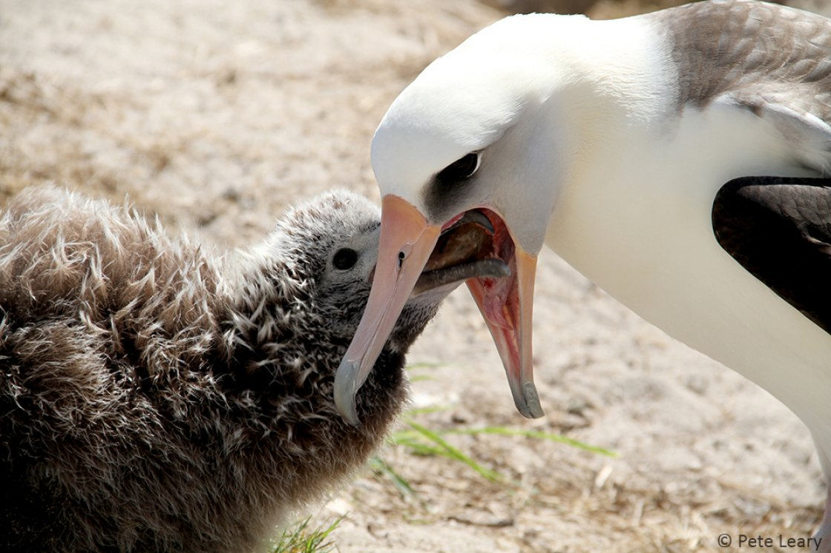
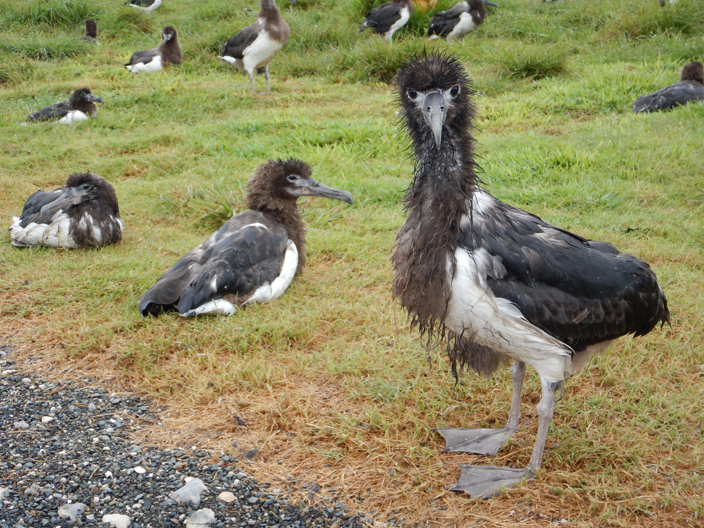
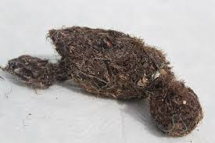
Notes:
Once we start thinking about why an albatross eats these things and what they consume, we then have to consider where there food goes. During nesting season, albatross do not simply poop out there food and other stomach contents after eating, they feed a lot of it straight to their chicks! So if the parent has plastic, the chick gets plastic.
Albatross parents take turns caring for the chick and foraging (looking for food), when the forager returns they regurgitate fish oil and other things to the chicks mouth. The chick grows and grows, and over time will change in appearance. Increase in size, feathers replace down, they look super awkward at times! & then, the parents leave the chick. Forced to act by hunger, the chick needs to learn to fly. Before this first flight though, called FLEDGING, the chick needs to lose some weight. To do so, the chicks throws up all of the things that its stomach could not digest (natural adaptation to remove things such as squid beaks and fish eye lenses, now we find plastic!).

Slide 18
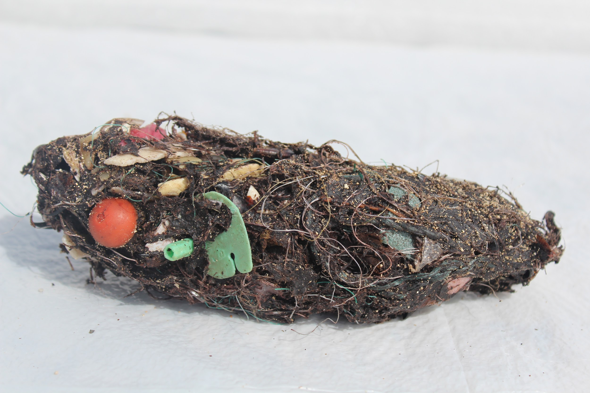
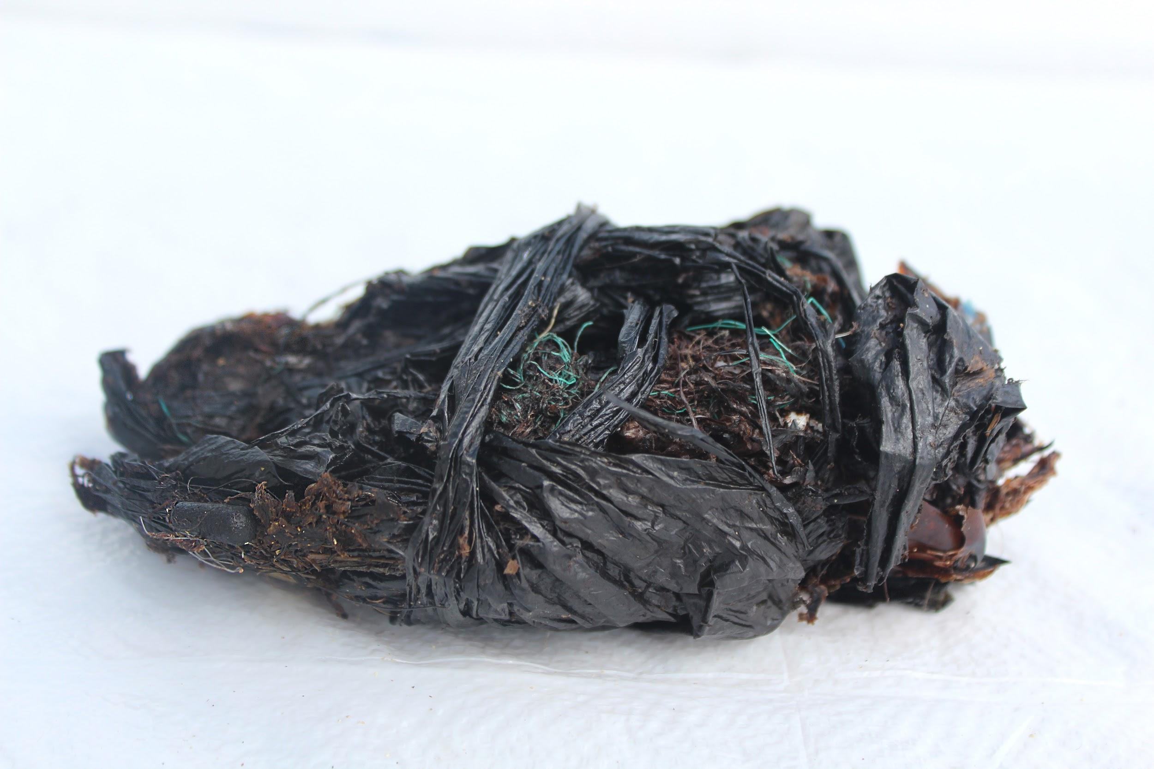
Why Boluses?
Bolus dissection is a non-intrusive method to study diet.
Bolus production is a natural adaptation to remove indigestible material from the chick’s body & lighten them for flight.
Provides a new way of looking at human impact on the environment.

Slide 19
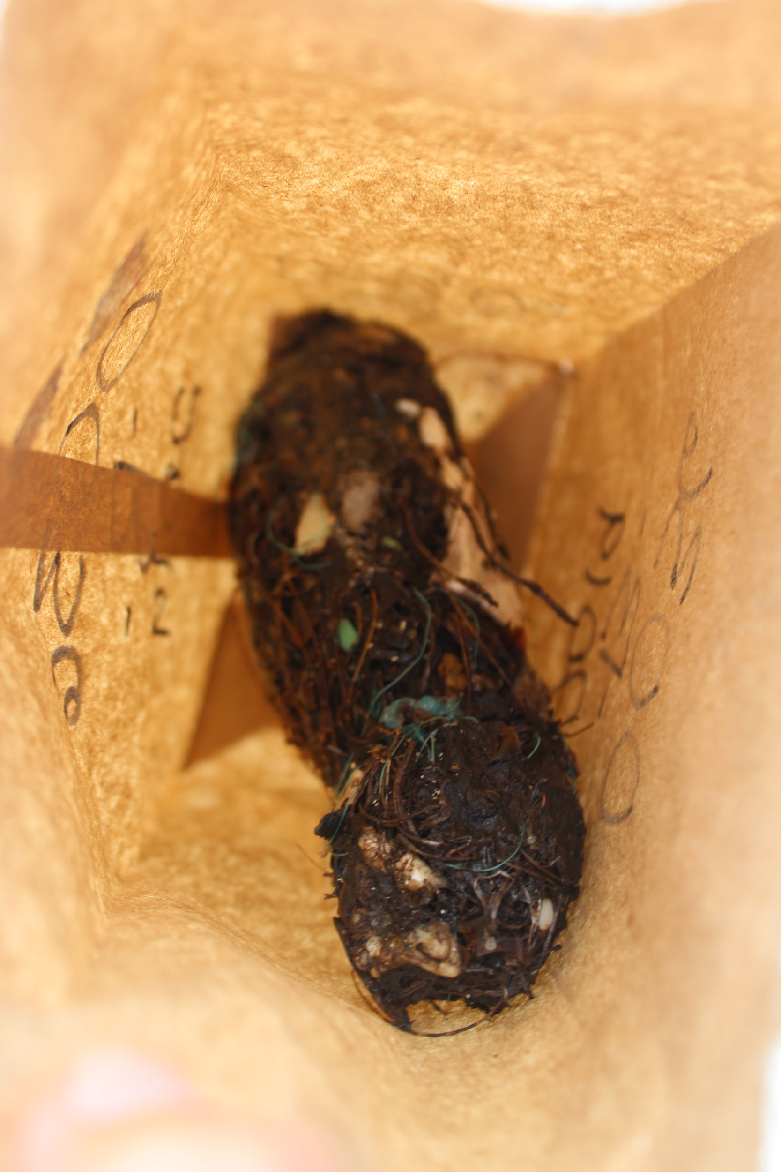
BOLUS DISSECTION
1 bolus will be given to a group of 2-6 students.
As a team you will dissect, identify, measure, & categorize the contents of your bolus.
Fill out your worksheet as a group! Answer all questions & we will discuss post-dissection.
HAVE FUN!

Slide 20
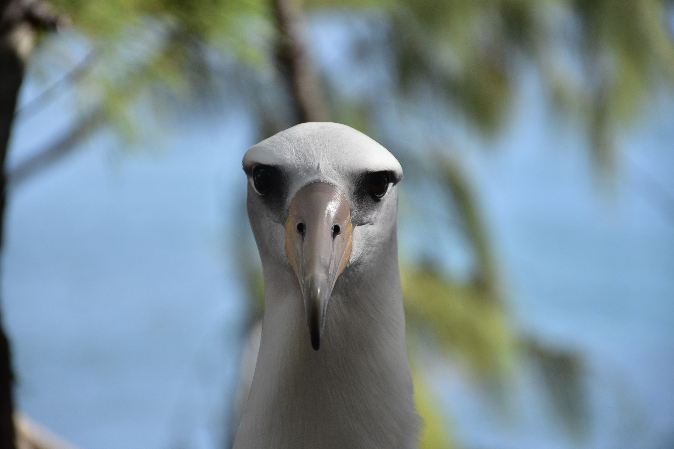
THANK YOU

