Slide 1
Lead-Free Voluntary Incentive Pilots
Navigating a collaborative approach to addressing lead poisoning in wildlife

Slide 2
Background
In 2022, FWS began a deliberate and collaborative process to find the best solution to lead poisoning in wildlife
As part of the process, FWS requested recommendations from the HWCC
In 2023, the HWCC recommended a voluntary approach based on education and incentives
In 2024, FWS, the HWCC, State wildlife agencies, and the North American Non-Lead Partnership (NANLP) have shaped a pilot program to test lead-free incentives on NWRs

Slide 3
Goals and Objectives
Driving purpose behind this pilot program is to address lead poisoning in wildlife
Overarching goal is to develop a proven model for addressing the issue through voluntary lead-free incentives
For 2024 pilots, the key objectives are:
Kick-start the pilot program
Test variations among pilot sites (e.g., State, target species, regulations)
Collect and evaluate data
Compile lessons for 2025 pilots
Notes:
A viable and effective model could be used by FWS throughout the Refuge System and could be used by other land and wildlife managers
We have to start somewhere. We need to overcome inertia and begin to build . We cannot let perfect be the enemy of good and give into the temptation to tinker with the design of the pilots forever, besides, implementation on the ground is going to expose flaws in any design no matter what. These are pilots, so we will be incorporating lessons learned year-over-year and expect to build from a minimum viable pilot to the Cadillac version of a pilot. Eventually reaching an ideal model. Finally, getting incentives out sooner means we are beginning to realize benefits to wildlife sooner.

Slide 4
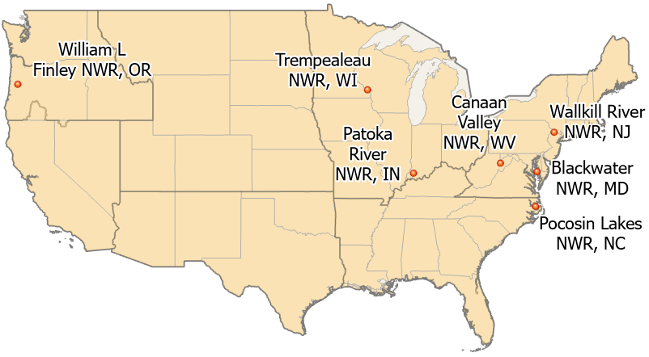
2024 Pilot Sites

Slide 5
2024 Pilot Sites
FWS has selected 7 Refuges to host lead-free pilots in Fall 2024
The selections were made based on robust internal considerations at all levels of FWS, plus critical and substantial input from HWCC members and State wildlife agencies
The selected pilot sites are:
William L. Finley NWR in Oregon
Patoka River NWR in Indiana
Trempealeau NWR in Wisconsin
Pocosin Lakes NWR in North Carolina
Wallkill River NWR in New Jersey
Blackwater NWR in Maryland
Canaan Valley NWR in West Virginia

Slide 6
Progress & Next Steps
Concept Paper
Site Selection
Pilot Design
Funding Agreements
Crafting Messaging
2024 Implementation
2024 Evaluation
Back to Site Selection, for 2025

Slide 7
2024 Pilot Design Overview
FWS is still refining and finalizing the design of the 2024 pilots
The 2024 pilots are designed to be sufficient and efficient, not ideal, and will provide a starting point for further refinement
Major components of pilot designs are:
Notifying Hunters
Providing Rebates
Collecting Data
Evaluating Data
The 3 NE pilots will concurrently run an ammunition testing incentive program and interactive educational workshops

Slide 8
Notifying Hunters
FWS will notify hunters about the…
Availability of the rebate incentive for lead-free ammo purchases
URL for the web portal to submit proofs of purchase
FWS will use existing touchpoints with hunters to notify participants in the designated hunts at each pilot site
Touchpoints include…
Permit mailings
Refuge hunting brochures
Check stations and Refuge signage
Trainings, workshops, and demonstrations
Notes:
We believe existing touchpoints will be sufficient and that adding additional touchpoints solely for purposes of notification or data collection would negatively affect hunter perceptions of the pilot program. If additional touchpoints are needed in the future, they should be voluntary and provide some benefit to the hunter, such as the ammunition testing and interactive workshops contemplated for the three 2024 pilots in the NE.

Slide 9
Collecting Data
FWS will operate designated hunts at pilot sites as normal, but collect associated data
FWS will collect data from our employees related to the implementation of the pilots
FWS will seek to collect data from all or a subset of the participating hunters, such as…
Use of lead or lead-free ammunition
Impact of the incentive on ammunition choice
Knowledge and opinion of lead-free ammunition
Opinion of notifications and messaging for the pilot, and their impact on ammunition choice

Slide 10
Providing Rebates
An experienced contractor will design the web portal for hunters to upload their proofs of purchase and validate the submissions
The planned rebate incentive is one $50 prepaid debit card per box of ammunition purchased, with a limit of two boxes per hunter ($100)
Costs of web portal and validation projected as ~$15,000
The cost of directly providing the cash card rebates for all pilot sites is projected to be approximately $43,000 in total

Slide 11
Evaluating Data
FWS Human Dimensions personnel will evaluate feedback from staff to improve the efficiency and effectiveness of the pilots
FWS will also evaluate hunter data to see the impact of variations across pilots on the effectiveness of the rebate incentive
Insights from the data evaluation will help FWS, State wildlife agencies, the NANL Partnership, and our other partners to…
Modify pilot designs for 2025
Modify messaging for 2025
Select 2025 pilot sites

Slide 12
Augmented Pilots
The 3 pilot sites in the Northeast (FWS Region 5) will augment the core pilot design with added programming and incentives
Hunters will receive a lead-free ammunition give-away incentive for volunteering to test out a variety of lead-free ammunition options and provide feedback
Each pilot site will host interactive educational workshops on lead-free ammunition performance, run by NANL Partnership
These additional pilot elements will be considered for future use at more sites and across a greater geographic range, informed by evaluation of the collected data

Slide 13
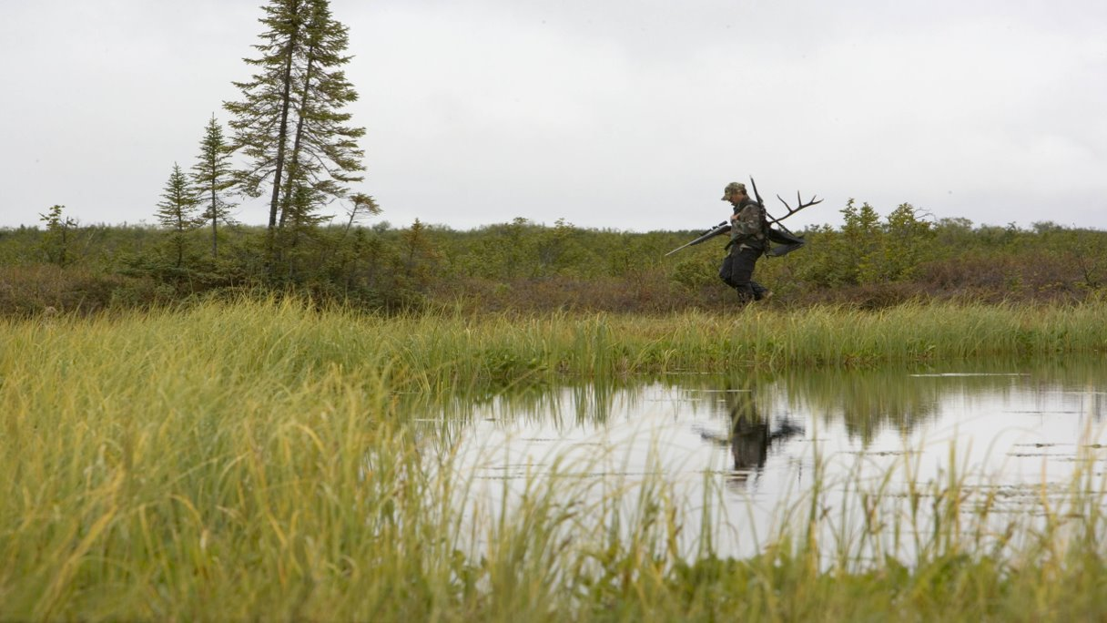
Thank You

